Slide 1
Education Ontology for Software Engineering
UML Test Environment
Asya Stoyanova-doycheva
Emil Doychev

Slide 2
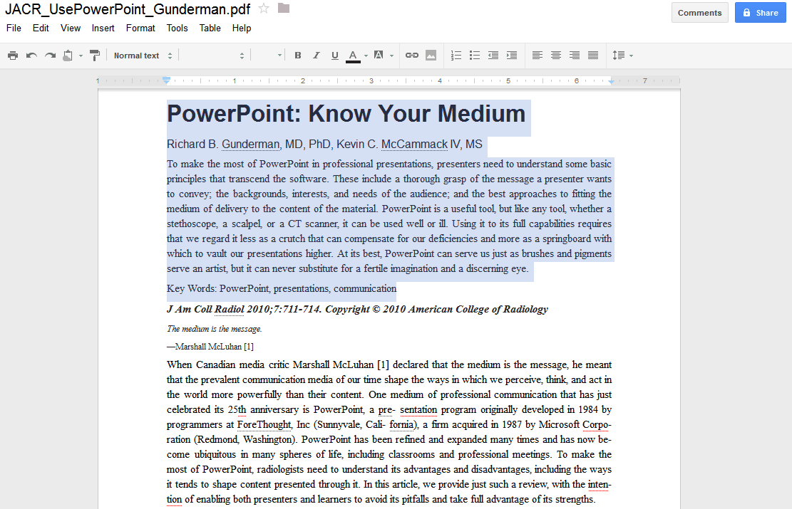
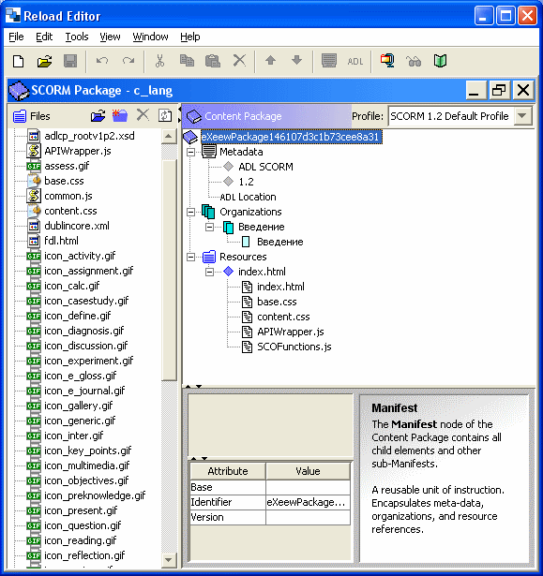
DigLib in Virtual Education Space
Repositories
Operatives
Management
Ontologies
QuestionerAgents
SCOs elements
ContentA
Student Assistent
e-packages in SCORM
SCOA
ePackA
digLibAssistent
Test Questions Date Bases
TestA
Statistic Data Bases
Teacher Assistant
StatisticA

Slide 3
UML Test Environment Functionality
Main function of the environment is to create tests about UML, present them to students in an appropriate way and check the answers, given by the users.
Such test contains a number of questions, which are designed to be a short answer questions. All of the questions in one test are different.
Notes:
When the work of the environment starts, a test begins. The first question is generated and displayed for the user.
For every question the user has defined time for answering. When answering a question is done, the system checks if that was the last question. If it’s not, a new question starts and the whole procedure repeats.
When the answer of the last question is checked, the results are shown to the user. So he can see how many of his answers are correct and how many are the wrong ones. Also it is displayed which of the questions have false answers, so students can analyze their knowledge and catch up the missed information.

Slide 4
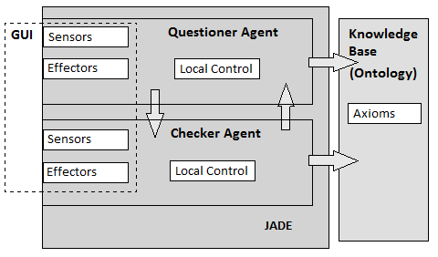
UML –Test Environment (Architecture)
Front-end component – Graphical User Interface (GUI), which users use for communicating with the environment to make the UML test;
Back-end component – set of Intelligent Agents (IA), which generate the tests, check the user’s answers and analyze the results. For this task they use the UML ontology as knowledge base.
The main two agents in the environment are named respectively Questioner Agent (QA) and Assessment Agent (AA). Each of them has its own specific tasks.
Assessment Agent
Notes:
All other UML elements at the form of classes are subclasses of one these. For example the class UseCaseDiagram is a subclass of Diagram, so it can be concluded that the use case diagram is a kind of diagram.
The created properties in the ontology and the existential and universal constraints establish the relations between classes. So that we can say how a UML element could be connected to another one or what is its function.
The classes, their hierarchy, properties and constraints form the axioms of the ontology. These axioms are rules about UML domain. They are the key of semantic processing of the knowledge by the agents.

Slide 5
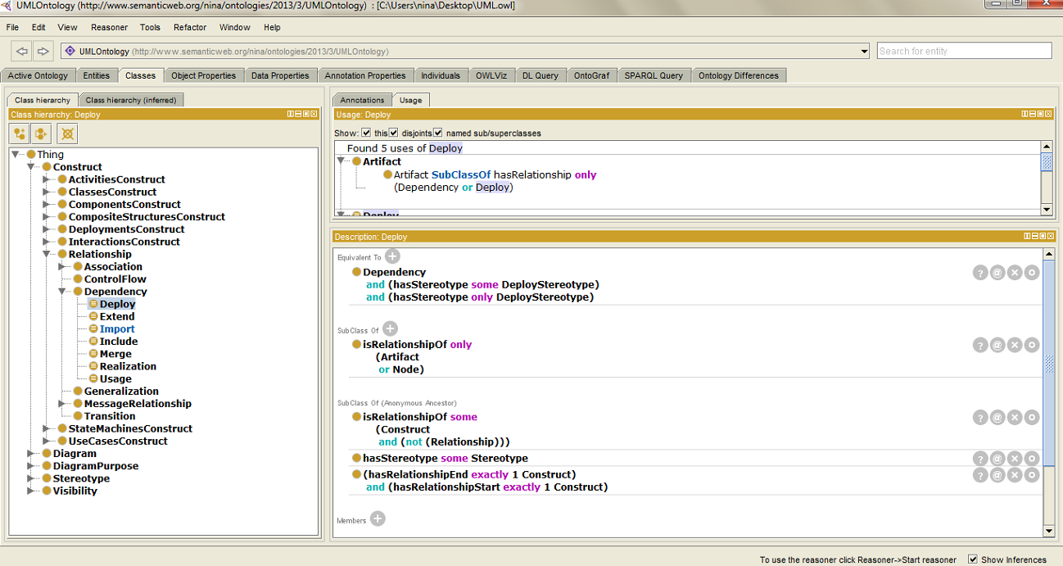
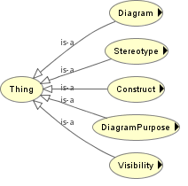
Implementation of the knowledge base
The knowledge base is an ontology in the UML domain. Its aim is to provide knowledge for the UML elements – which are they and what relations have between each other.
Our ontology contains over 850 axioms, so that gives variety of questions that can be asked by UML TE.
Notes:
There are five classes, which are the main classes on the first level of the hierarchy. All other UML elements at the form of classes are subclasses of one these. For example the class UseCaseDiagram is a subclass of Diagram, so it can be concluded that the use case diagram is a kind of diagram.
The created properties in the ontology and the existential and universal constraints establish the relations between classes. So that we can say how a UML element could be connected to another one or what is its function.
The classes, their hierarchy, properties and constraints form the axioms of the ontology. These axioms are rules about UML domain. They are the key of semantic processing of the knowledge by the agents.

Slide 6
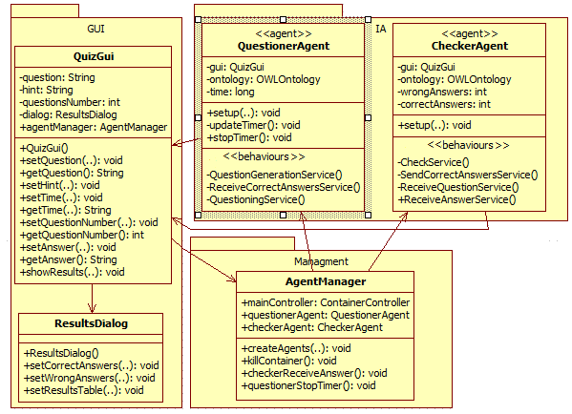
Implementation of the UML Test Environment

Slide 7
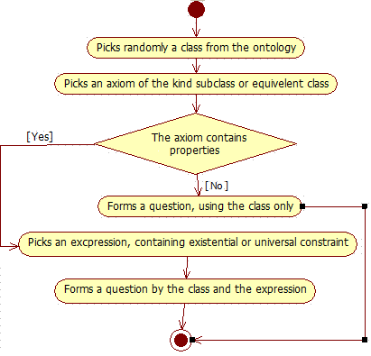
Implementation of the Questioner Agent
The most interesting and important behavior of this agent is QuestionGenerationService. It implements the logic for composing the questions, using the knowledge from the ontology
For example if the picked class is InteractionDiagram, the question will be “InteractionDiagram is”. The user has to finish the sentence with the correct UML element. In this case that is behavioral diagram, because the interaction diagram is a kind of behavioral diagram.
For example, it is chosen UseCase to be the class and the picked expression says that it can be related by the property hasRelationship with the classes BidirectionalAssociation or Include or Extend. The formed question will be UseCase hasRelationship and the user should finish the sentence.
Notes:
The generation of a question is based on axioms in the knowledge base. The first step of the algorithm (Fig. 8) is to be picked a class, representing some UML element, from the ontology. This happens by choosing randomly a class from all of the ontology classes, which are extracted into a set.

Slide 8
Implementation of the Assessment Agent
Behaviors of the Assessment Agent:
receive, the name of the class and the string of the axiom from QA. They are extracted in OWLClass and OWLAxiom objects, so they can be used for the checking later.
Receive the answer of the question from the GUI
Assessment Service is activated, when the question and the answer are received.
SendCorrectAnswersService - send the results, when they are asked.

Slide 9
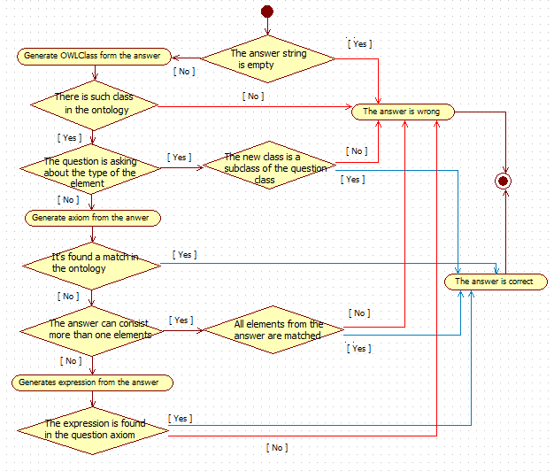
Assessment Service Algorithm
1. Is the answer string empty?
2. Is there such class in the ontology?
3. Defining the type of the question?
3.1 If the type of the question is “Is” - the answer should match with one of the super or equivalent classes of the question class.
3.2 If the type of the question is not “is”, we will use the axiom that was sent by QA:
3.2.1: The Agent founds matching in ontology.
3.2.2 Doesn't found matching - we have to divide this case to several subcases, because of the different types of axioms - ObjectAllValuesFrom or ObjectSomeValuesFrom, ObjectUnionOf expression
3.2.3 Generate expression from the answer
Notes:
The algorithm for assessment (Fig. 10) is based on the knowledge base and it has several branches for establishing the truth of the answer. When the agent is ready with the conclusion for the answer, new string (true or false) is put in the vector, holding the results and checking ends.
At first it is get only the first element from the vector, which keeps the answer, because the first case will depend on it.
To check the answer, the type of the question has to be defined. If its last three symbols are “is” it asks about the UML element. So the answer should match with one of the super or equivalent classes of the class from the question. If this happens the answer is true. If there is not match it is considered to be false. In both cases the assessment ends.
For the upper situation, it is used only the class, from which the question is generated. But if this is not the case, we will use the axiom that was sent by QA. There is three variants here.
The first idea is to construct an axiom, using the string of the question from the GUI and the string of the user’s answer. It will be compared to the real axiom and according to this the agent will make a conclusion about the answer.
To fulfil this, we have to divide this case to several subcases, because of the different types of axioms. So it is created an axiom, which is of the type EquivelentClasses or SubClassOf. This axiom has expression in itself, which is ObjectAllValuesFrom or ObjectSomeValuesFrom. The types depend on the information, which was sent by QA. So if this axiom is equal or is part of the string, taken by QA, the answer is true. If this condition is not satisfied, but the constructed axiom is contained by the ontology, the answer is also considered to be true.
If it’s not found match again, the agent pass to the next case, where the received axiom contains an ObjectUnionOf expression. We assume that the user is written more than one UML elements in the answer. So here is the place where all of the elements of the vector, holding the answers are used. In the implemented logic is enough all of the elements from the answer to be true. It’s not mandatory all elements from the axiom to be written from the user. So the agent just checks if every answer element is part of the ObjectUnionOf expression. If they do, the answer is true, if they don’t – it’s false.
The last case is implementing the logic, when any of the upper cases was not executed. It extracts an OWLClassExpression object from the answer axiom and compares it with the sent expression. The result of this assessment is the conclusion for the answer’s truth.

Slide 10
Implementation Technologies
JAVA
JADE
Eclipse
Protégé OWL
OWL API

Slide 11
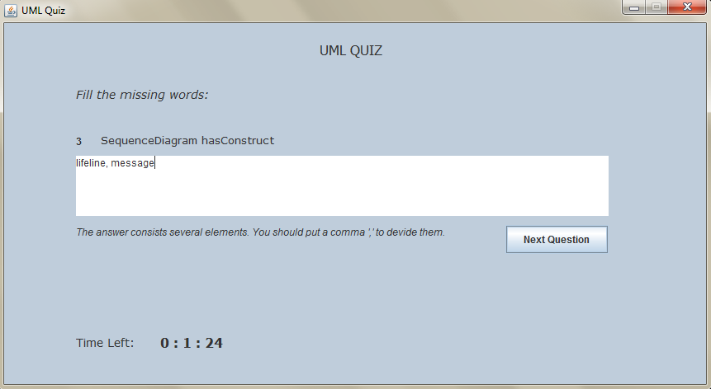
GUI of the Test Environment

Slide 12
Conclusions
FUTURE WORK
We will improve the ontologies in way to be more suitable about question generator ( to be more understandable).
We will improve the implementation of the agents ( for example to collect information about the wrong questions for the each student and include them in their future tests).
We will try to include another type of questions.

Slide 13
Thank you!

